Slide 1

RAS
4th
WS

Slide 2
RAS
4th
WS
Hello!

Slide 3
ROBOTICS & AUTOMATION
BVPIEEE
Robotics and Automation Society (RAS)

Slide 4
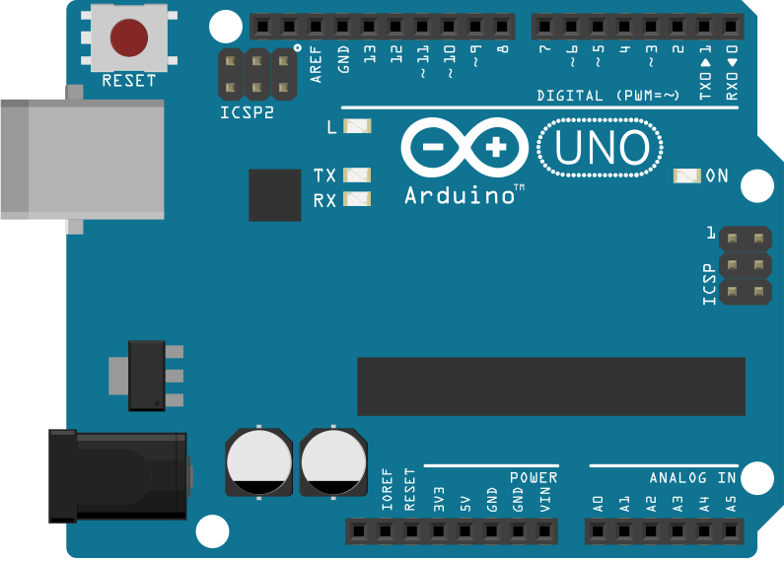
Arduino
Arduino is an open-source platform
Arduino IDE (Integrated Development Environment)

Slide 5
Arduino
What is an Arduino?
Why use Arduino?
Types of arduinos
Pro mini
Nano
Uno
Mega

Slide 6
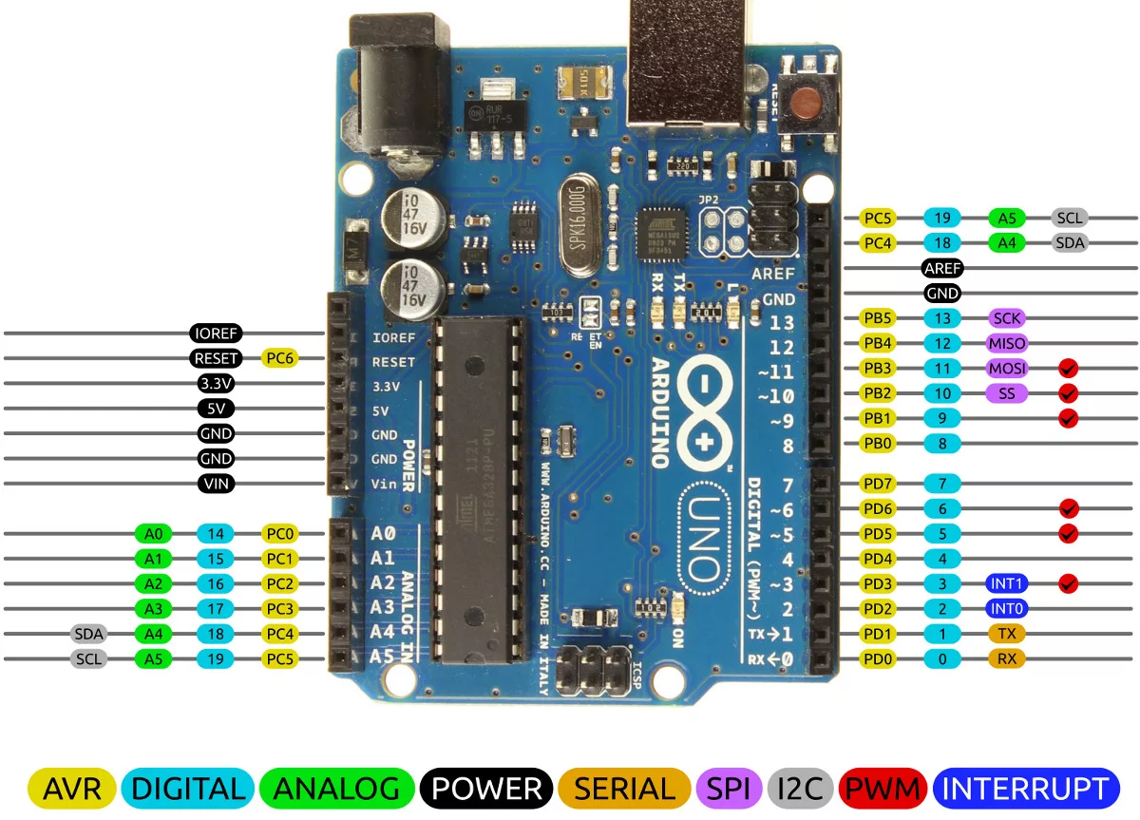

Slide 7
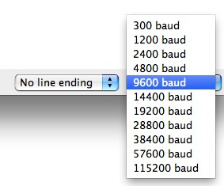
Baud Rate
The rate at which individual bits of data are sent is called the
baud rate.

Slide 8
UART
(Universal Asynchronous Receiver/Transmitter )

Slide 9
UART is a form of serial communication because data is transmitted as sequential bits (we’ll get to this in a bit). The wiring involved with setting up UART communication is very simple :
One line for transmitting data (TX) and one line for receiving data (RX).

Slide 10
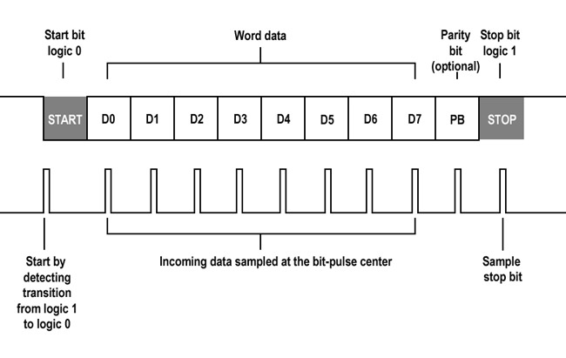

Slide 11
SPI
(Serial Peripheral Interface)

Slide 12
SPI is different from UART in several key ways:
Synchronous
Follows a master-slave model, where there is one master device and multiple slave devices
More than two lines required for implementation

Slide 13
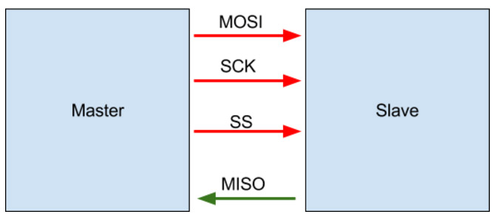

Slide 14
I2C
(Inter Integrated Circuit)

Slide 15
Advantage over the others in some applications include:
The ability to connect multiple masters to multiple slaves
Synchronicity (just like SPI), which means higher speed communication
Simplicity: implementation only requires two wires and some resistors

Slide 16
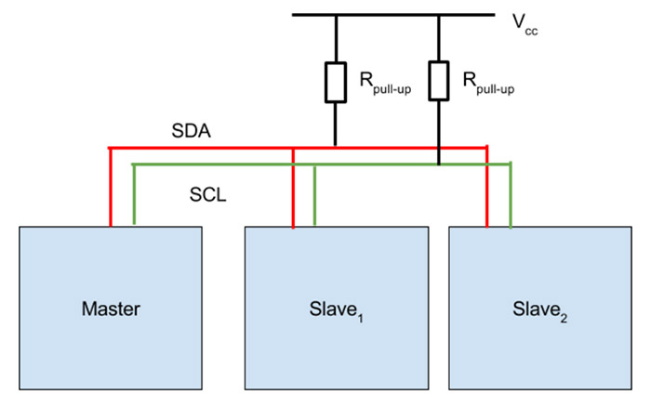

Slide 18
Lets talk to the Internet!

Slide 19
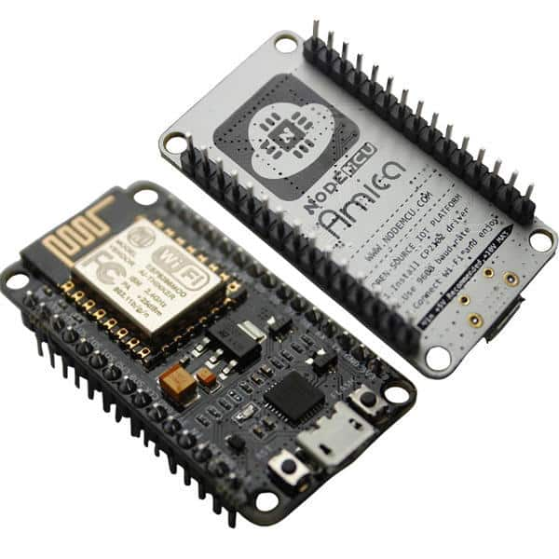
Nodemcu
NodeMCU Development Kit/Board consist of ESP8266 wifi chip. ESP8266 chip ESP8266 is a low-cost Wi-Fi chip developed by Espressif Systems with TCP/IP protocol has GPIO pins,serial communication protocol etc making it perfect for IoT!

Slide 20
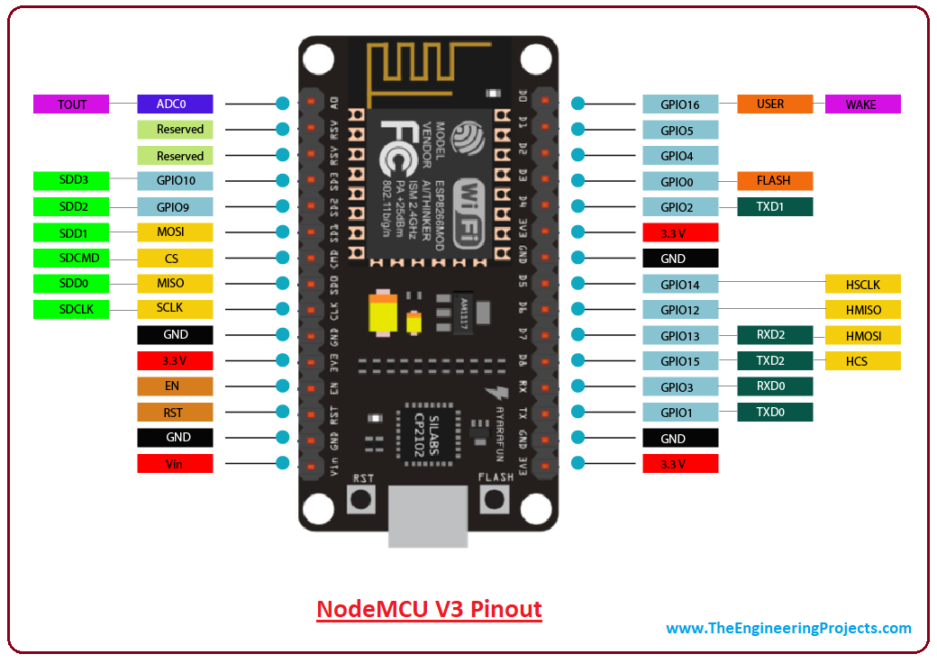

Slide 21
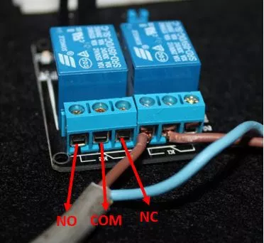
Relay
A relay is an electrically operated switch that can be turned on or off, letting the current go through or not, and can be controlled with low voltages

